Slide 1
Smart Tourist Safety Monitoring & Incident Response System using AI, Geo-Fencing, and Blockchain-based Digital ID
CSE7302- University Project
Final Viva
Batch Number: CAI_13
Under the Supervision of,
Dr. Srinivasan TR
Professor
School of Computer Science and Engineering
Presidency University
Roll Number | Student Name
20221CAI0150 | Sandeep S
20231CAI3005 | Manish Kumar Sharma
20221CAI0149 | Muhammed Umar Rizwan
Name of the Program: B.Tech CAI
Name of the HoD: Dr. Zafar Ali Khan
Name of the Program Project Coordinator: Ms. Suma NG
Name of the School Project Coordinators: Dr. Sampath A K , Dr. Geetha A

Slide 2
Content
Problem Statement
Proposed Solution
Key Objectives
System Architecture
Tech Stack
Core Methodology
UI Showcase
Evaluation and Results
Future Enhancements
Conclusion

Slide 3
Problem Statement Number: SIH25002
Organization: Ministry of Development of North Eastern Region (MoDoNER)
Category : Software
Problem Statement: The Tourism Connectivity Gap
Network-Dark Terrains: Traditional SOS mobile apps fail in deep forests and remote high-altitude zones without
4G/LTE.
Reactive vs. Proactive: Current systems rely on the victim manually triggering an alert, which is impossible
if incapacitated.
Costly & Slow Rescues: Manual patrols and delayed search-and-rescue operations cost governments millions
and reduce tourist survival rates.
The Hardware Barrier: Commercial satellite devices cost over $400, making mass state-sponsored
deployment impossible.

Slide 4
The Proposed Solution: TourSafe360
A proactive, edge-computed, and data-driven ecosystem.
Automated Diagnostics: Replaces manual check-ins with continuous, real-time anomaly detection.
Phase 1 Prototype Validation: Proven software ecosystem using mobile sensor proxies (gyroscopes)
and cloud-native backends.
Phase 2 Hardware Vision: Designed for future integration with ₹1,820 custom ESP32 wearables and
LoRaWAN mesh gateways.
Decentralized Intelligence: Runs powerful AI models locally without cloud dependency.

Slide 5
Key Objectives:
Project Objectives:
Live Diagnostic Capacity: Implement continuous physical telemetry tracking (accelerometer/gyroscope).
Predictive Fall & AI Triage: Achieve high-accuracy anomaly detection and automated medical severity scoring.
Automated Geo-Fencing: Issue real-time perimeter violation alerts via dynamic spatial boundaries.
Low-Latency Command Integration: Build an interactive React.js dashboard for police dispatch under 300ms.
Multilingual Support: Integrate localized AI for tourist safety assistance.

Slide 6
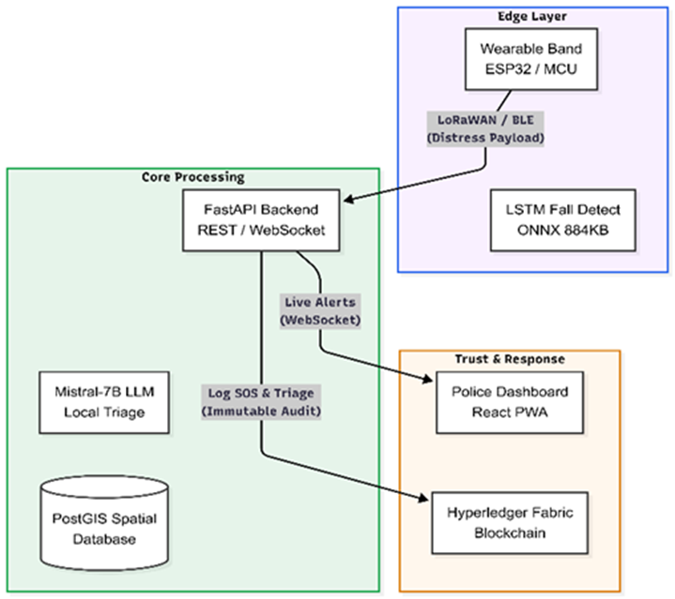
System Architecture :
Presentation Layer: Flutter Mobile App & React.js Police Dashboard.
API Gateway: FastAPI (Python) with WebSocket orchestration.
AI Engine: PyTorch (LSTM) + Ollama (Mistral-7B).
Data Layer: PostgreSQL + PostGIS for spatial geometries.

Slide 7
The Technology Stack
Phase 1 PoC Technology Stack:
System Component | Technology Implemented
Edge Machine Learning | ONNX (LSTM Architecture), PyTorch
Independent Triage Agent | Mistral-7B (4-bit Quantized) Ollama
Backend / Spatial Logic | PostgreSQL, PostGIS, FastAPI
Real-Time Orchestration | WebSockets, Socket.IO
Frontend Interfaces | Flutter (Mobile), React.js (Web)

Slide 8
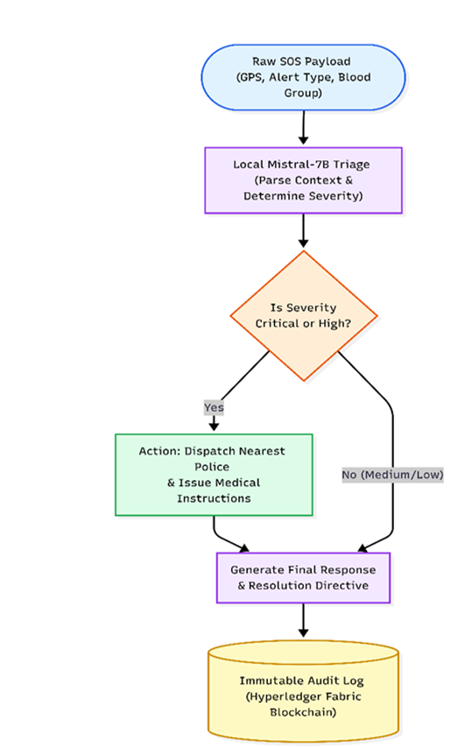
Core Methodology:
Threshold Trigger: App detects acceleration spike (e.g., > 3.8g).
AI Parsing: Mistral-7B processes the context (GPS, profile, impact magnitude).
Severity Classification: AI determines if the gap is Low, Medium, or Critical.
Automated Dispatch: System generates specific equipment recommendations (e.g., Stretcher, 4x4 Jeep) for ground teams.

Slide 9
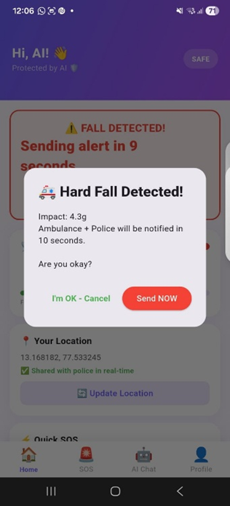

UI Showcase - Mobile Apps : Tourist & Patrol Interfaces (Flutter)
Native Sensor Proxies: Real-time accelerometer background tracking.
AI Safety Assistant: Llama3.2 powered multilingual chat (20+ languages).
Ground Patrol Routing: Officer dispatch with AI medical summaries.

Slide 10
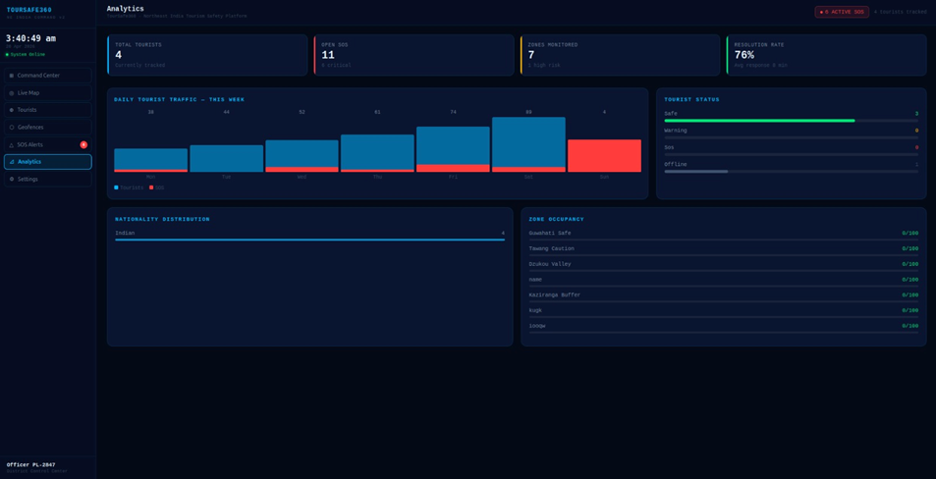
UI Showcase - Command Center :Real-Time Police Web Dashboard (React.js)
Live Spatial Map: Leaflet integration for moving markers.
Dynamic Geo-Fencing: Visualizing safe zones and restricted perimeters.
Active Incident Queue: Instant WebSocket alerts for regional monitoring.

Slide 11
Evaluation & Results
AI Fall Detection Accuracy: 85.0%
F1-Score (Sensor Data): 86.0%
System Response Time: < 300 ms (Sub-second target achieved)
Triage Severity Identification: 94.2% accuracy in testing vs. manual triage.

Slide 12
Future Enhancements
Custom Wearables: Transitioning from smartphone proxies to ESP32-S3 microcontroller bands with MAX30102 sensors (SpO2/Heart Rate).
Offline Connectivity: Deploying LoRaWAN mesh gateways to ensure telemetry transmission in absolute network dead zones.
Immutable Auditing: Implementing Hyperledger Fabric (v2.5) blockchain to securely record all SOS events for state disaster management compliance.

Slide 13
Conclusion
SDG 8 & 9 Alignment: Fostering sustainable eco-tourism and building resilient digital infrastructure in North East India.
Cost-Effective Scalability: Mass-deployable architecture vastly cheaper than commercial satellite tracking.
Empowering Authorities: Shifting emergency management from reactive guesswork to proactive, AI-driven precision.

Slide 14


